Slide 1
Note: The data and information in this document is reflective of a hypothetical situation and client. This document is to be used for KPMG Virtual Internship purposes only.
Sprocket Central Pty Ltd
Data analytics approach
Asraful Islam, Junior Data Analyst
asrafuldu126@gmail.com

Slide 2
Note: The data and information in this document is reflective of a hypothetical situation and client. This document is to be used for KPMG Virtual Internship purposes only.
Agenda
Introduction
Data Exploration
Model Development
Interpretation

Slide 3
Sprocket Central Pty Ltd provided us a dataset of 1000 customers with their demographics and attributes consisting of the following fields
Note: The data and information in this document is reflective of a hypothetical situation and client. This document is to be used for KPMG Virtual Internship purposes only.
Introduction
gender
past_3_years_bike_related_purchases
DOB
job_title
job_industry_category
wealth_segment
owns_car
tenure
address
postcode
state
country
property_valuation
rank
value
Our job is to analyse the dataset and recommend which of these 1000 customers should be targeted to drive the most value for the organisation

Slide 4
Note: The data and information in this document is reflective of a hypothetical situation and client. This document is to be used for KPMG Virtual Internship purposes only.
Data Exploration
Dataset has 15 fields and 1000 records
Our main focus is on the field value and other fields that value depends on
Eventually, the fields address, postcode, country are redundant
DOB is transformed to age, year, month_number
gender, job_title, job_industry_category, wealth_segment, owns_car, state are categorical fields and purchases, tenure, property_valuation, rank, value, age, year, month_number are numerical fields
There is no duplicate records
job_title, job_industry_category, and age has 106, 165, and 17 blank records respectively

Slide 5
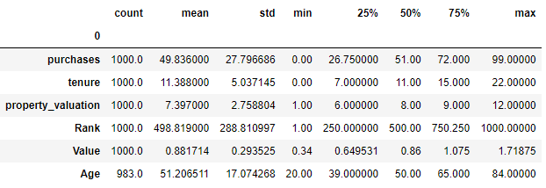
Note: The data and information in this document is reflective of a hypothetical situation and client. This document is to be used for KPMG Virtual Internship purposes only.
Data Exploration
The numerical fields have the following statistics:

Slide 6
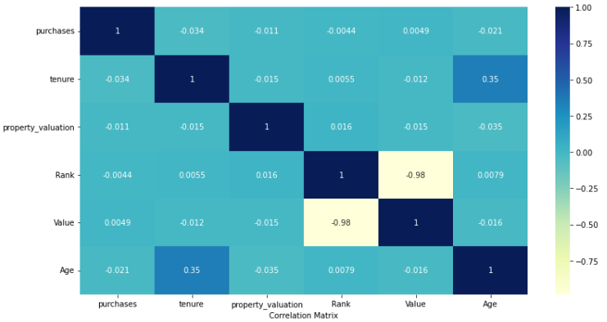
Note: The data and information in this document is reflective of a hypothetical situation and client. This document is to be used for KPMG Virtual Internship purposes only.
Data Exploration
The numerical fields have the following correlation:
The correlation coefficient –0.98 between value and rank indicates that the fields are significantly and negatively correlated.

Slide 7
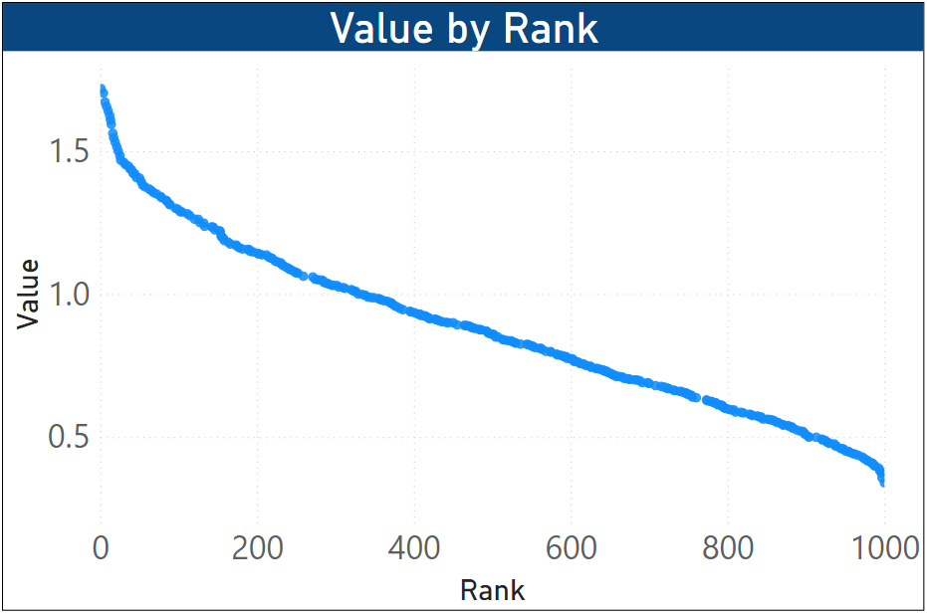
Note: The data and information in this document is reflective of a hypothetical situation and client. This document is to be used for KPMG Virtual Internship purposes only.
Model Development
Profit based on customer rank:
Customers are ranked from 1 to 100.
Lesser the rank, more the profit

Slide 8
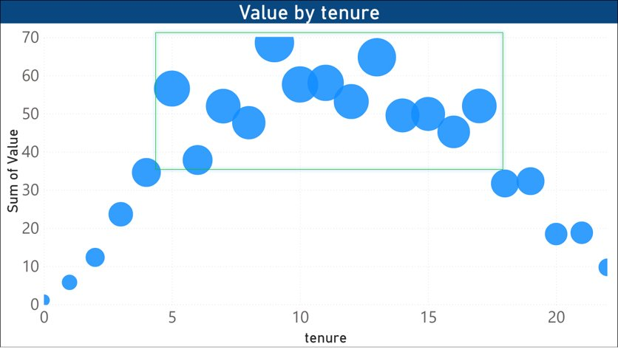
Note: The data and information in this document is reflective of a hypothetical situation and client. This document is to be used for KPMG Virtual Internship purposes only.
Model Development
Profit based on Tenure:
Customers with Tenure ranging from 5 to 15 would bring more profit

Slide 9
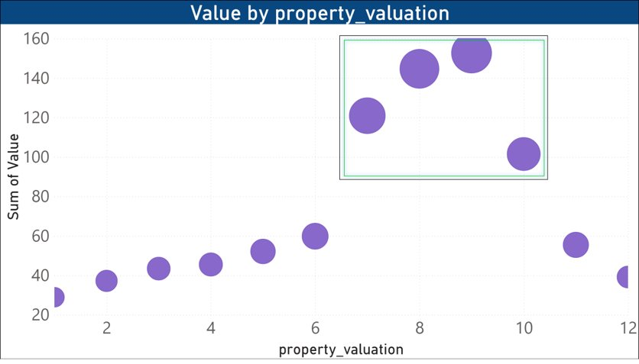
Note: The data and information in this document is reflective of a hypothetical situation and client. This document is to be used for KPMG Virtual Internship purposes only.
Model Development
Profit based on Property valuation:
Customers who have property valuation between 7 to 10 would bring more profit

Slide 10
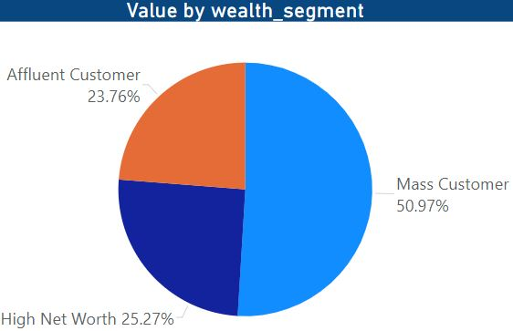
Note: The data and information in this document is reflective of a hypothetical situation and client. This document is to be used for KPMG Virtual Internship purposes only.
Model Development
Profit based on wealth segment:
Mass Customers are the most profitable segment who contribute nearly 50% of the profit

Slide 11
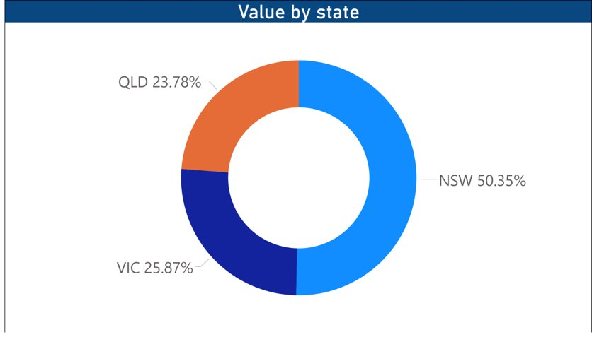
Note: The data and information in this document is reflective of a hypothetical situation and client. This document is to be used for KPMG Virtual Internship purposes only.
Model Development
Profit based on states in Australia:
Customers living in New South Wales are the most profitable customers with more than 50% profit among the other States.

Slide 12
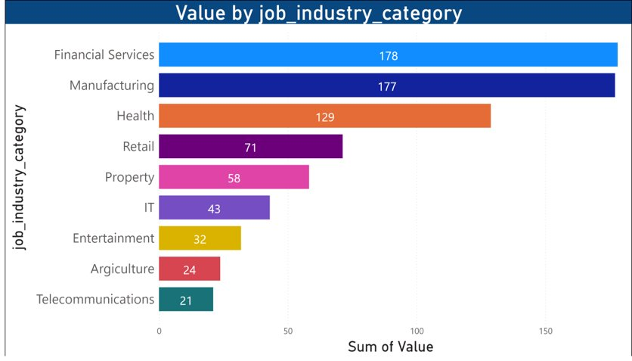
Note: The data and information in this document is reflective of a hypothetical situation and client. This document is to be used for KPMG Virtual Internship purposes only.
Model Development
Profit based on job industry:
Customers working in Financial services, Manufacturing showing most of the profit, followed by Health and other job categories

Slide 13
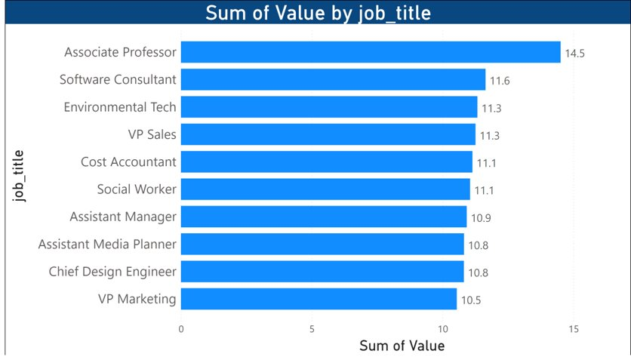
Note: The data and information in this document is reflective of a hypothetical situation and client. This document is to be used for KPMG Virtual Internship purposes only.
Model Development
Profit based on job title:
Associate Professors stand at the first position to be targeted for profit followed by other job holders with almost similar contribution

Slide 14
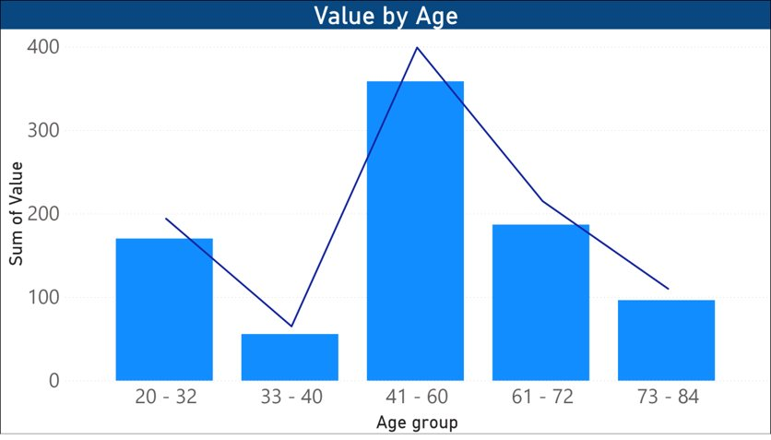
Note: The data and information in this document is reflective of a hypothetical situation and client. This document is to be used for KPMG Virtual Internship purposes only.
Model Development
Profit based on Customers age:
The customers between 41 to 60 ages are the most profitable.

Slide 15
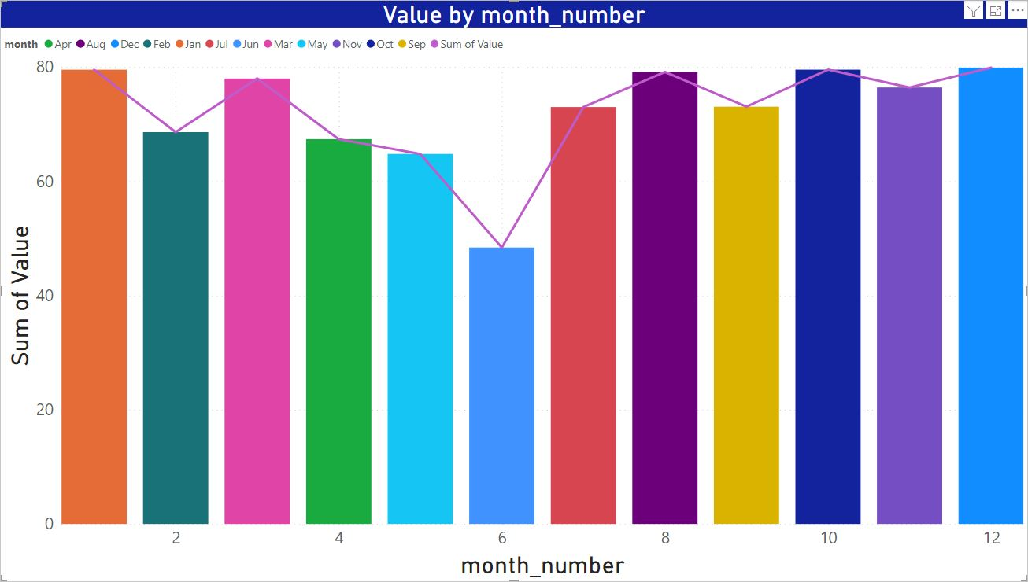
Note: The data and information in this document is reflective of a hypothetical situation and client. This document is to be used for KPMG Virtual Internship purposes only.
Model Development
Profit trending of month:
Profit on the second half of a year is consistent although a good profit can be made in January and March

Slide 16
Note: The data and information in this document is reflective of a hypothetical situation and client. This document is to be used for KPMG Virtual Internship purposes only.
Interpretation
Target customer recommendation:
Ages: between 41 to 60
Profession: Associate professor, Software consultant
Job field: Financial services, manufacturing, health sector
State: New South Wales
Customer type: Mass customer
Property value: ranging from 7 to 10
Tenure: ranging 5 to 15
Month: Second half of a year, especially in October, November, and December

Slide 17
Note: The data and information in this document is reflective of a hypothetical situation and client. This document is to be used for KPMG Virtual Internship purposes only.
Thank You

